Slide 1
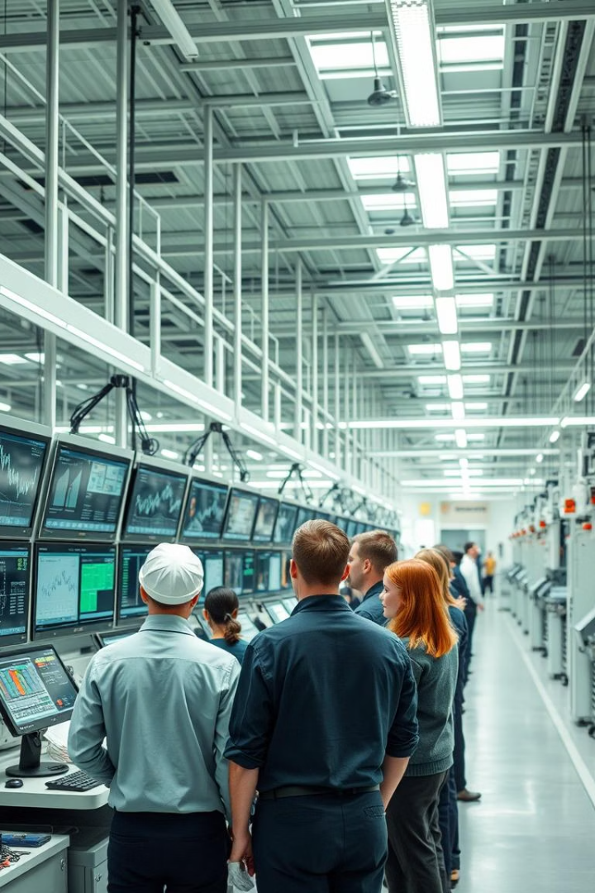
SAP ERP Advanced Manufacturing Simulation
Business plan and lessons learned by Team F at Muesli AG.

Slide 2




Team Roles & Collaboration
Production Lead
Strategy & Data Analyst
Financial Analyst
Mohit Tiwari
Mehar Singh Bawa
Aakriti Gurung
Managed scheduling, inventory, and demand alignment.
Led planning and data analysis using Power BI.
Tracked finances and ensured valuation goals.
Logistics Manager
Marketing Manager
Ritika Herwade
Jasmine Liamsuwan
Optimized stock transfers
and minimized costs.
Directed pricing and targeted
advertising campaigns.

Slide 3
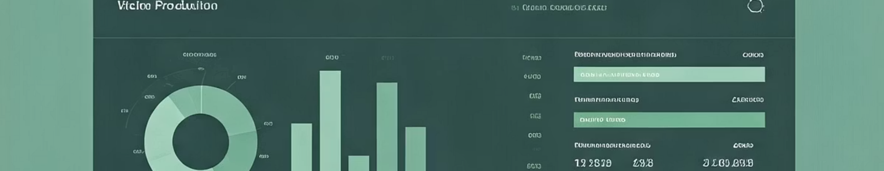
Key Performance Indicators
80%+
88%
10%
Production Capacity
Inventory Turnover
Cost Reduction
Maintained above 80% utilization through setup time reduction
Achieved by focusing on six high-performing products
Target for production cost per unit through optimizations

Slide 4
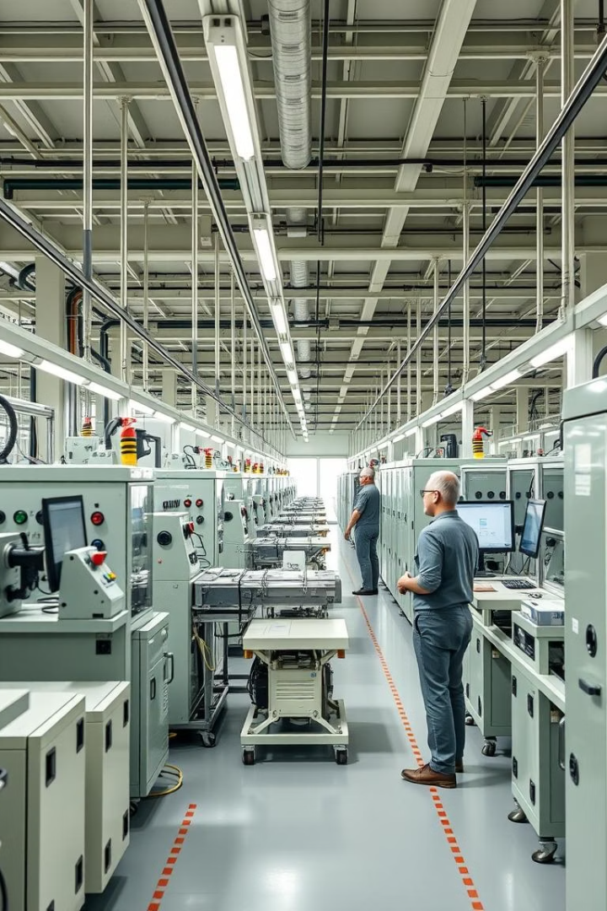
Production Focus & Efficiency
Initial Approach
Produced all 12 products, causing frequent setup delays.
Capacity Expansion
Increased capacity late, but complexity remained high.
Final Strategy
Focused on the top two products, reducing changeovers and boosting output.

Slide 5
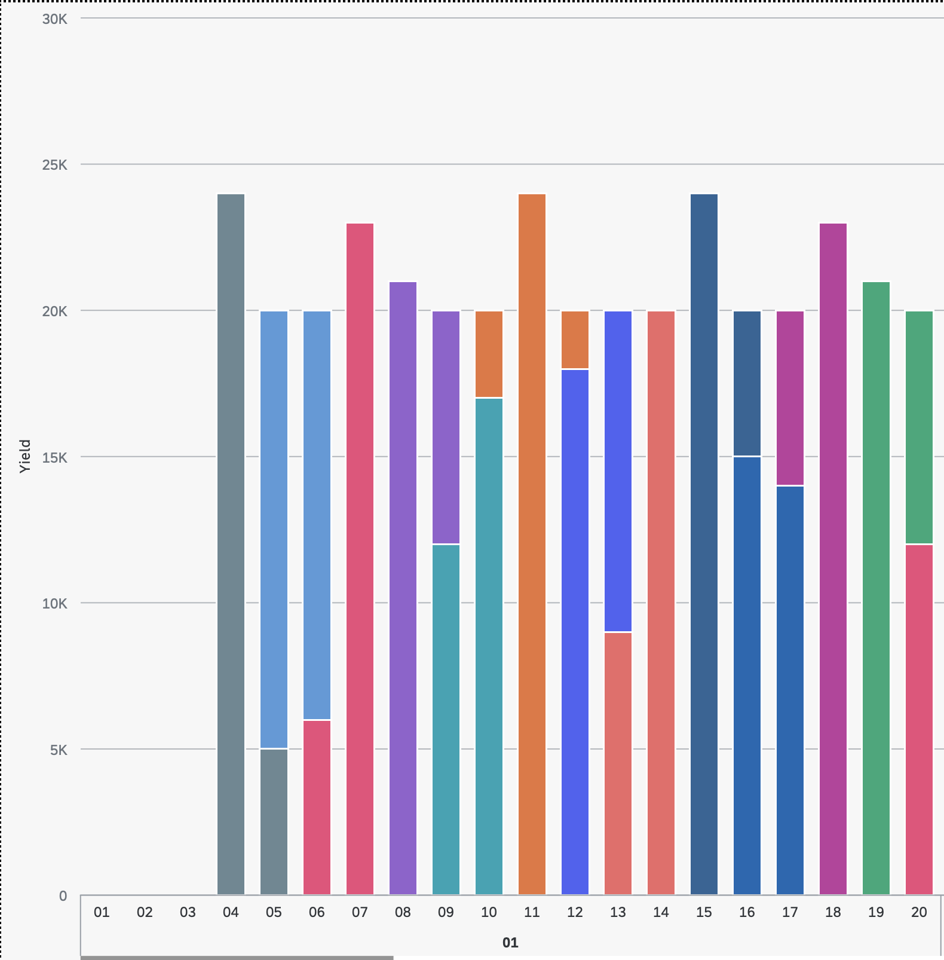
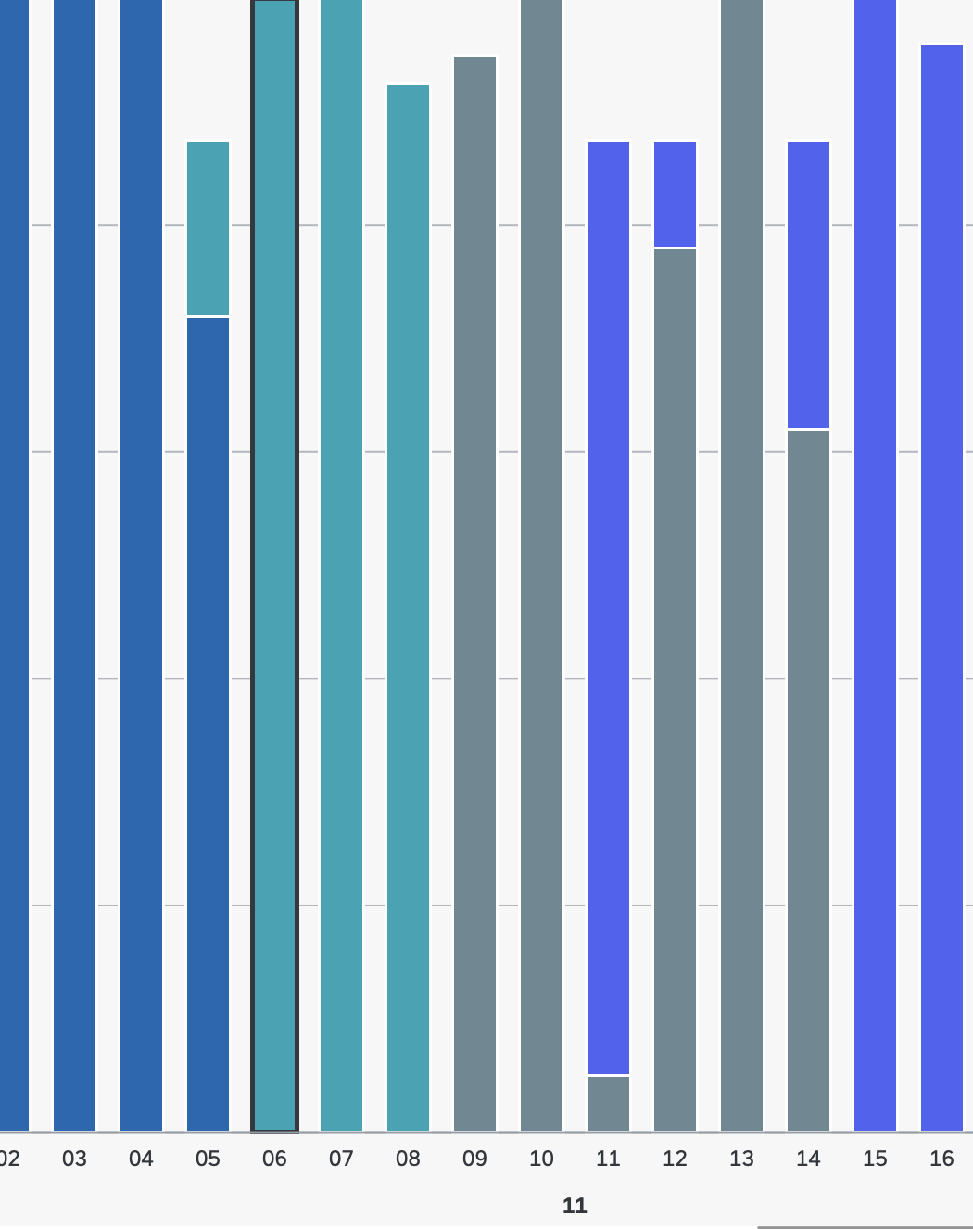
Before
After

Slide 6
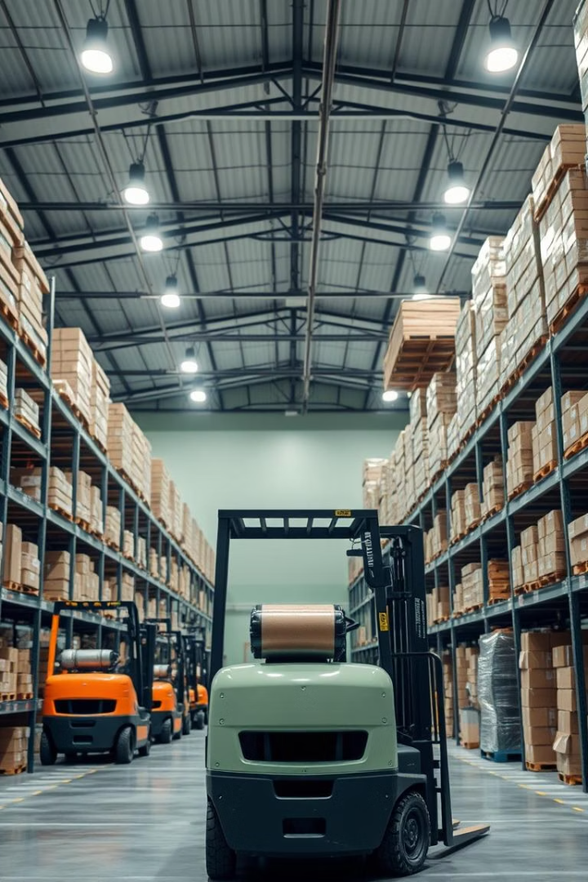




Planning & Stock Transfer Strategy
Push-Based Stock Transfer
Distributed inventory evenly to prevent stockouts early on.
Hybrid Push Model
Shifted inventory to high-demand regions using sales data.
MRP Execution
Weekly SAP runs ensured timely procurement and production.
Cost Control
Minimized warehousing expenses by balancing stock levels.

Slide 7
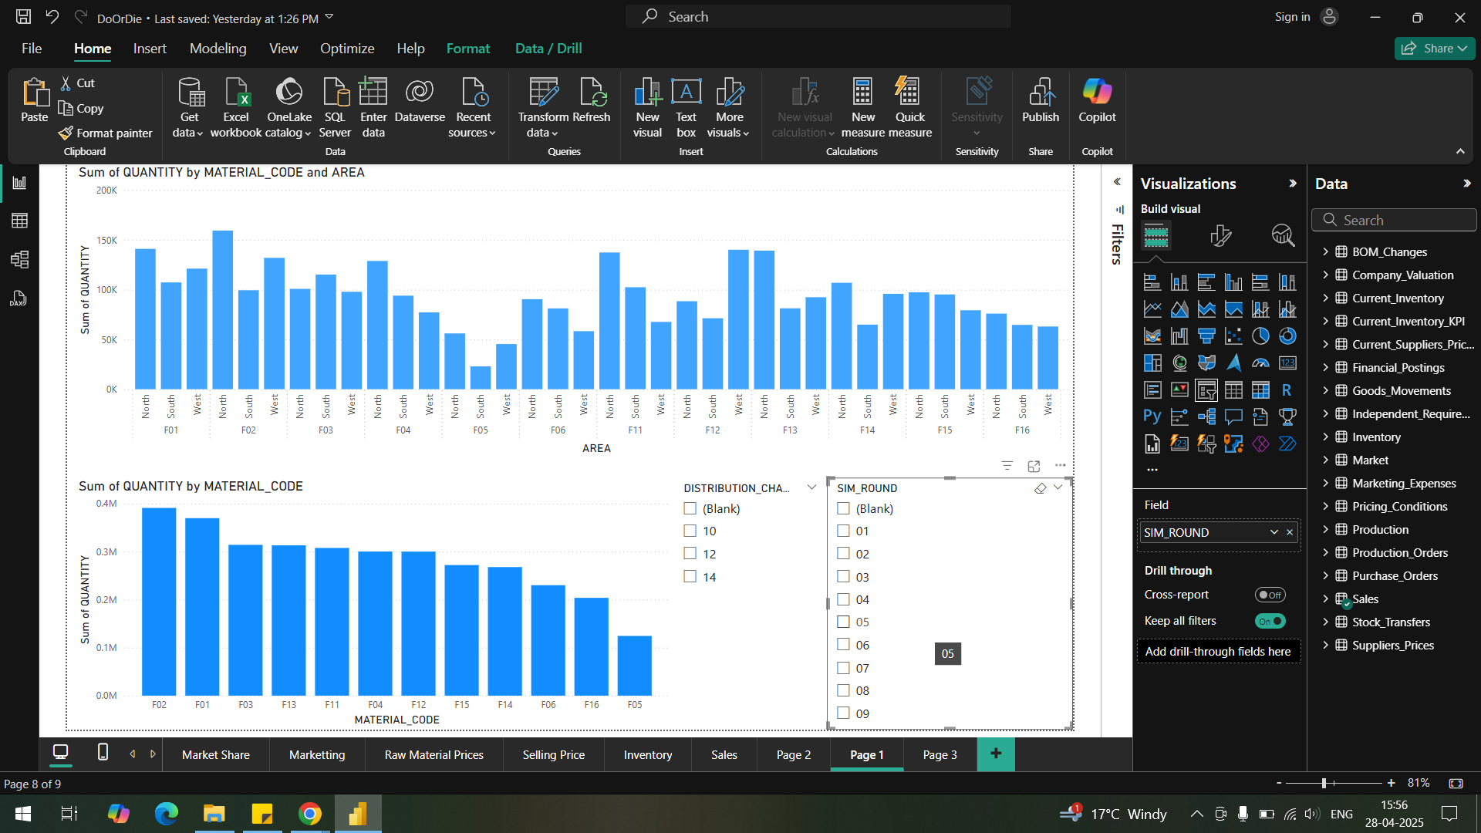
Dashboard Overview: Presents an analysis of material quantities using Microsoft Power BI.
Key Visualizations:
1. Area-based Quantity: Top bar chart
2. Material Code Quantity: Bottom bar chart
Interactive Distribution Channel Slicer: Filtering by distribution channel

Slide 8

Logistics & Cost Control
Stock Transfers
Warehouse Costs
End-Game Cash
Scheduled every 3-4 days to minimize transportation costs.
Monitored inventory to avoid exceeding 250,000-unit capacity.
Reversed non-essential investments to maximize liquidity and valuation.

Slide 9
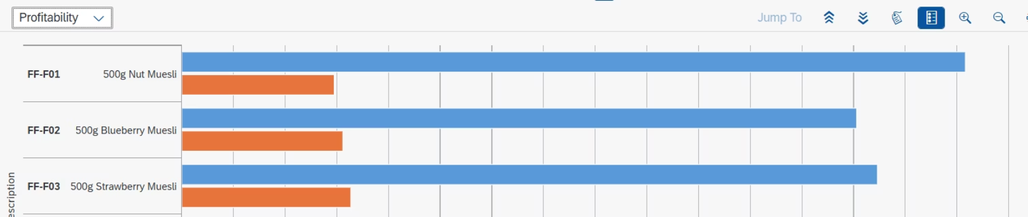
Pricing Strategy
Implemented a regional sensitivity model with dynamic daily price adjustments.
Monitored real-time market prices to stay competitive using an analytic tool.
Conducted profit analysis leveraging sales order report (Figure 3).
Lowered prices in the final round to clear inventory and enhance cash flow.
Figure 3

Slide 10
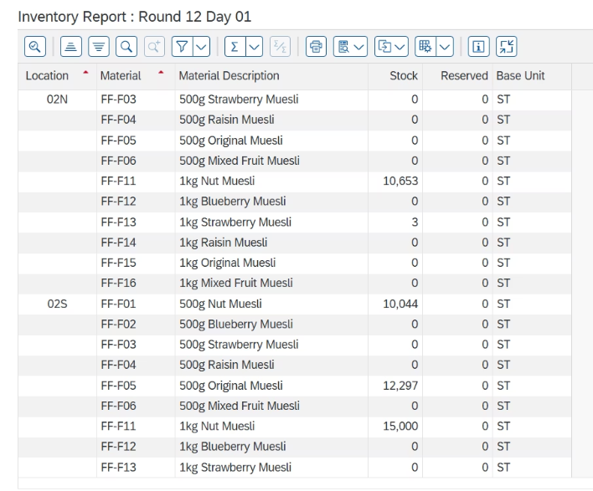
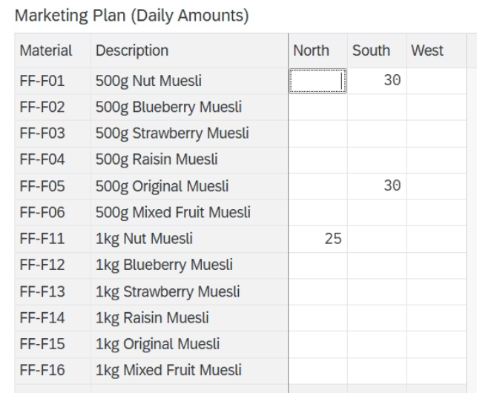
Marketing Strategy
Allocated budgets strategically to high-demand products and key regions based on stock transfer data (Figure 1).
Increased marketing spend on products requiring rapid sell-out for last round to clear out inventory (Figure 2).
Figure 2
Figure 1

Slide 11
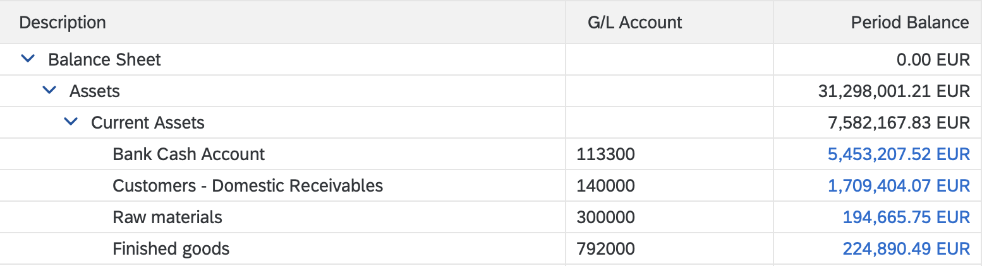
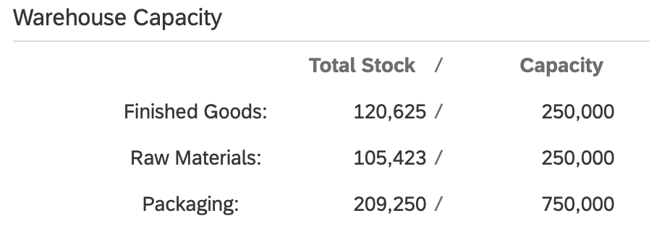
Financial Management & KPIs
Loan Repayment
Cash Flow
Key KPIs
Incremental $1M repayments improved credit rating and valuation.
Maintained $1-1.5M liquidity for operational flexibility.
10% reduction in production cost per unit
Capacity utilization above 80%
Increased inventory turnover

Slide 12
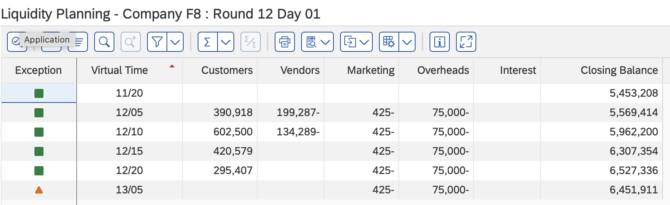
Liquidity Report
Cash Flow Management: Steady inflows, controlled outflows to maintain liquidity
Expense Control: Consistent marketing and overhead spending to stabilize costs
Receivables Focus: Timely collections to boost cash reserves
Interest Cost Minimization: Strategically managed loan repayments to reduce interest expenses
Liquidity Optimization: Analyzed liquidity to align expenses, production orders, and payments effectively

Slide 13

Competitive Business Strategies
Optimizing Production
Expense reduction
Reduced setup time from 8 to 3 hours, boosting capacity utilization above 80%.
Cut expensive ingredients to minimum standards, increasing margins.
Dynamic Pricing
Targeted Marketing
Used Power BI to stay competitive in price-sensitive channels.
Focused spend on high-opportunity regions and top products.
Notes:
Our stategies were motivated from michael porters competitive startegic framework and were based on minimizing operational cost and offer competitive pricing, while ensuring profitability.
We began by optimising production process
Next, we revised the Bill of Materials (BOM) for our strawberry and blueberry muesli products, cutting the percentage of expensive ingredients like strawberries and blueberries to the minimum allowable 20%.
maintain competitive pricing that appealed to price-sensitive customers like DC 10- grocery stores
we tracked competitors’ marketing investments by product and region each round

Slide 14
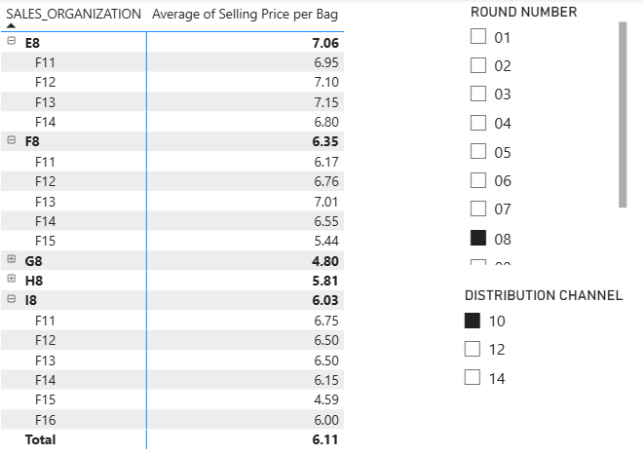
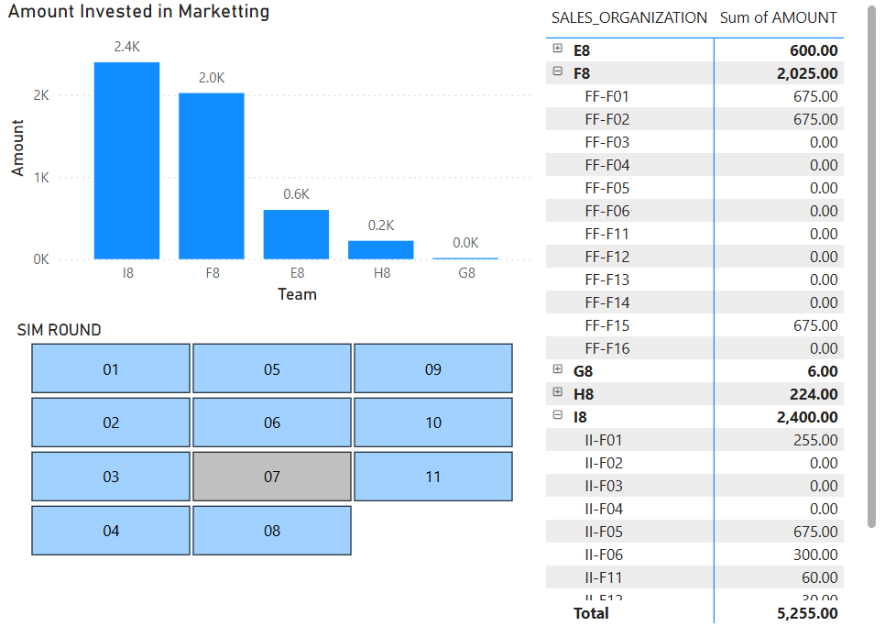
Price Comparison Dashboard
Marketing Investment Tracker
Notes:
We created these graphs using power BI. It helped in stategic decisions and KPI monitoring. It provided real time insights into production, pricing, and market trends
dashboard displaying our product prices alongside competitors’ prices across rounds. By monitoring this data, we adjusted our pricing to stay competitive, ensuring we attracted customers like grocery chains while covering our reduced costs. This visual was critical for maintaining market share in a price-sensitive market.
bar chart showing competitors’ marketing investments by product per round. This allowed us to identify where other teams were focusing their efforts and adapt our marketing budget accordingly. For instance, if a competitor heavily marketed Nut Muesli, we shifted focus to underserved areas, optimizing our spend and impact.

Slide 15
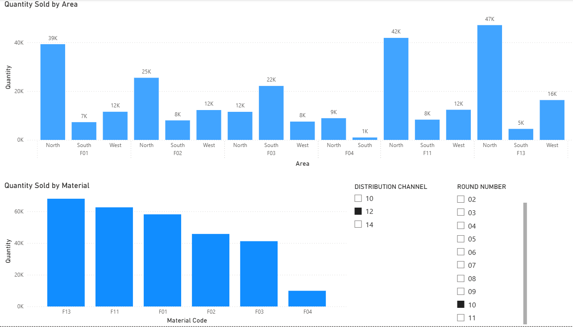
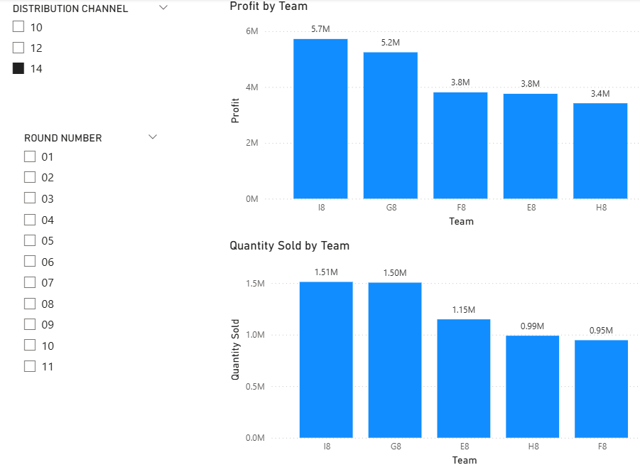
Overall Sales Performance Report
Sales Performance by DC and Round number
Notes:
bar graph tracked sales volumes by product and region, highlighting top performers like Strawberry Muesli 1kg. By round 8, it guided us to streamline production to six products, boosting our inventory turnover ratio and reducing excess stock. The report is linked directly to our KPI of increasing turnover, showing how production aligned with demand.
bar chart displayed quantity sold and profit earned per round, segmented by distribution channel. It provided clear insights into channel performance, showing which channels drove the highest sales volumes and profit margins. this visual guided our strategy to optimize production and pricing for each channel.

Slide 16
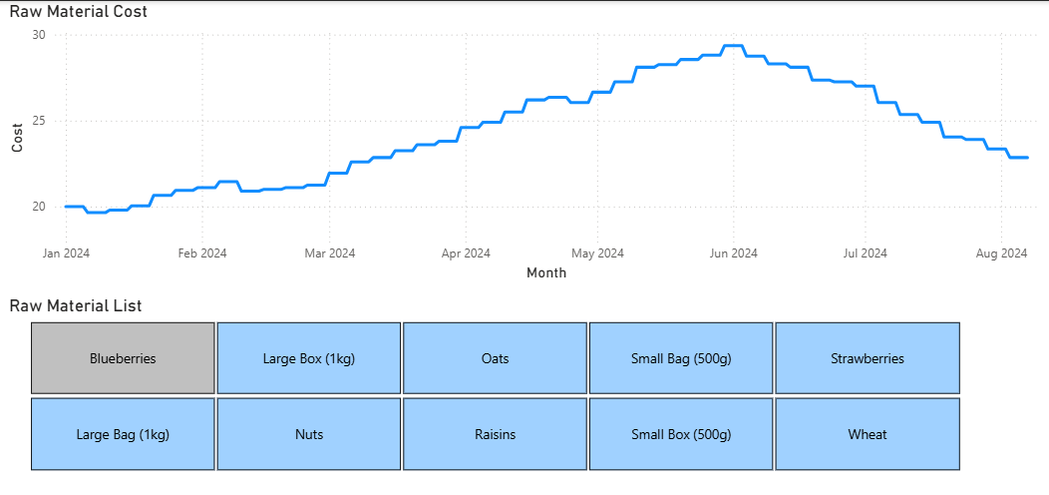
Raw Material Price Trends
Notes:
line chart tracked raw material prices over time, focusing on key ingredients like strawberries and blueberries, which showed decreasing prices during certain periods. By analysing these trends, we strategically increased the production of strawberry and blueberry muesli when costs dropped, lowering our variable expenses and improving profit margins.

Slide 17
Team Reflections on the Value of an ERP System
Key Benefits
Challenges
1
Streamlined Operations
1
Cost & Time
Integrates processes across departments, boosting efficiency and reducing errors.
High initial investment and implementation time.
2
Change Resistance
2
Data-Driven Decisions
Employees may struggle to adapt to new systems.
Centralizes data for real-time insights, enhancing strategic planning.
3
Complexity
3
Collaboration
Requires careful planning to avoid disruptions.
Provides a shared platform, improving team coordination and communication.
4
Scalability
Adapts to business growth, supporting long-term success.

Slide 18

Results & Reflection
Strong Performance
Key Successes
Areas to Improve
Ranked first in 7 of 11 rounds, finishing second overall.
Loan strategy, Cash flow
Dynamic pricing
Cost control.
Earlier capacity expansion
Tighter production-sales coordination,
Aggressive final marketing.

